Slide 1
Data communication & Network week 1 & 2
Tutor: Bilal Janjooa
MS Telecom. Eng. From University of Sunderland UK

Slide 2
Objectives
Describe how networks impact our daily lives.
Describe the role of data networking in the human network.
Identify the key components of any data network.
Identify the opportunities and challenges posed by converged networks.
Describe the characteristics of network architectures: fault tolerance, scalability, quality of service and security.

Slide 3
DATA COMMUNICATION
“Data Communication is the exchange of Information from one entity to the other using a Transmission Medium”

Slide 4
Data Communication Definition (Modified)
“Data Communication is the exchange of data (in the form of 0’s and 1’s) between two devices (computers) via some form of the transmission medium.”

Slide 5
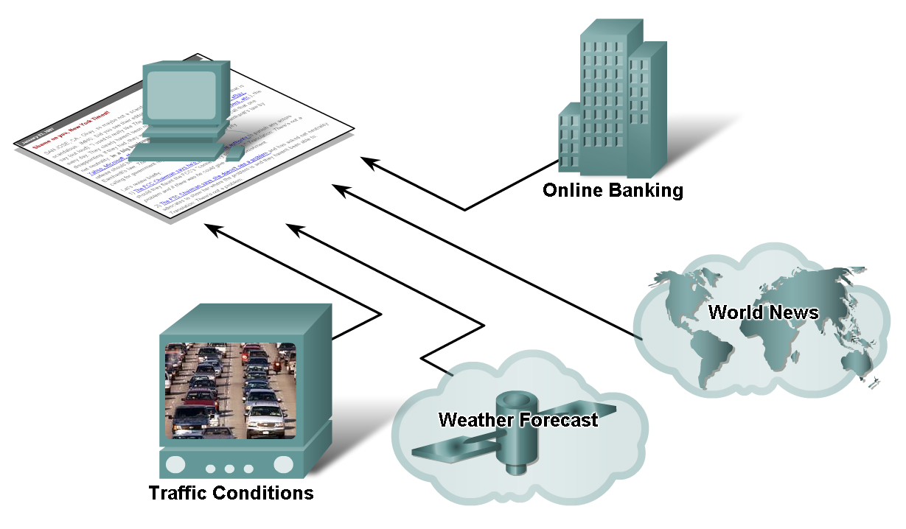
How Networks Impact on Daily Life
Explain the benefits of direct communication and how it supports and improves our lives.

Slide 6
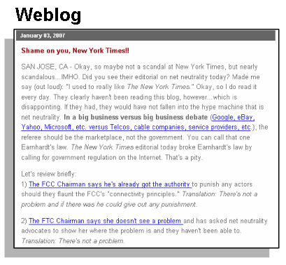

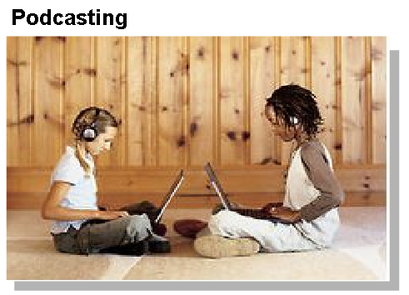
How Networks Impact Daily Life
Describe the characteristics and purpose of popular communication media such as, IM, Wikis , Blogs, Podcasting, and Collaboration Tools
Instant messaging
Real time communication
between 2 or more
people based on typed text
Weblogs (Blogs)
Web pages created by an individual
Podcasting
Website that contains
audio files available
for downloading

Slide 7
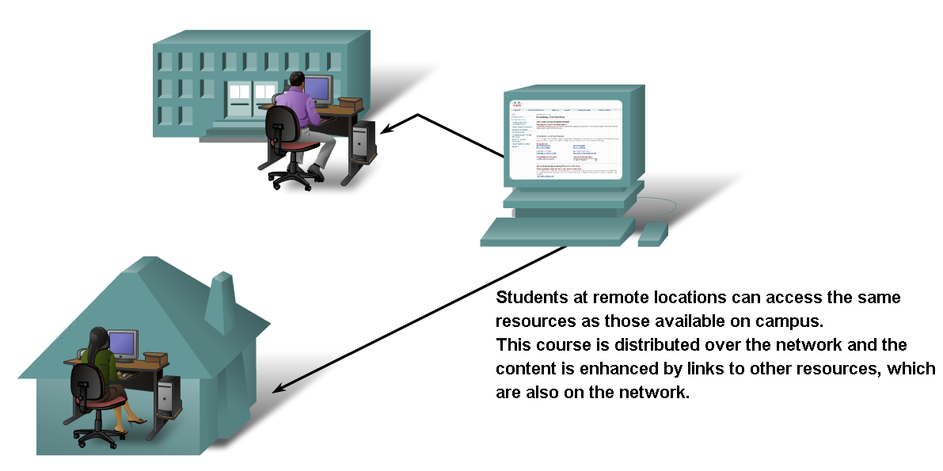
How Networks Impact Daily Life
Explain ways that using information networks to share and collaborate improves teaching and learning

Slide 8
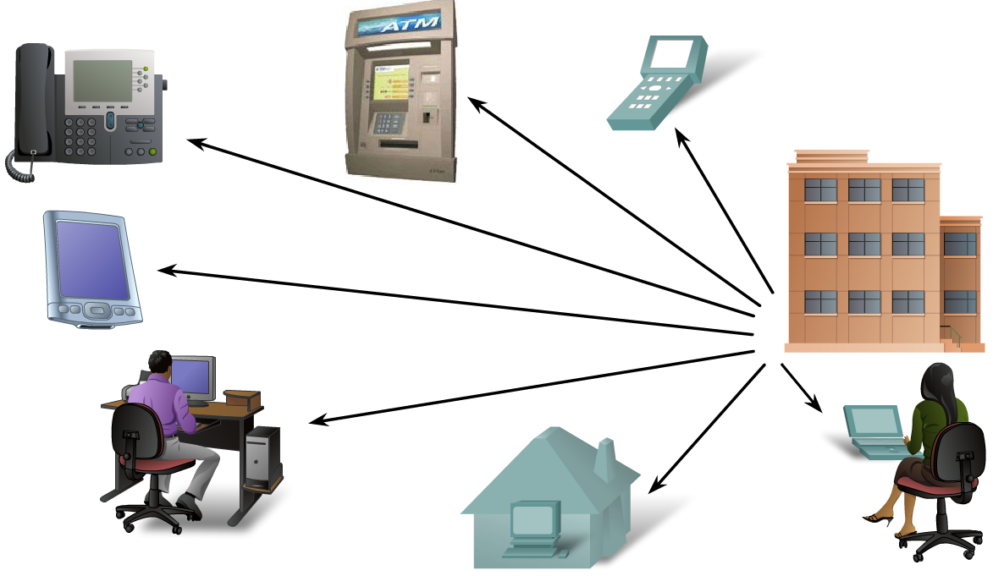
How Networks Impact Daily Life
Describe ways communication over a network changes the way we work

Slide 9
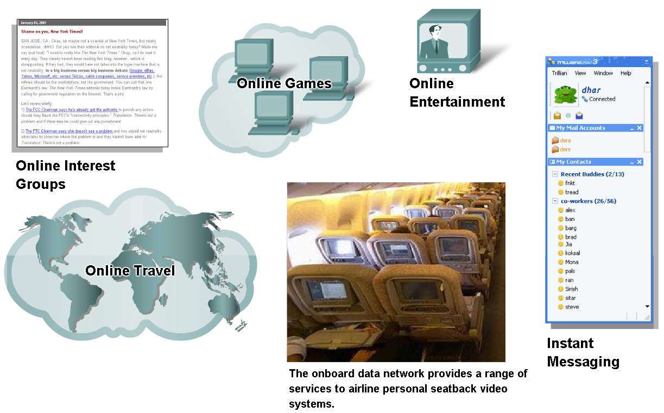
How Networks Impact Daily Life
Describe ways communication over a network supports the way we play

Slide 10
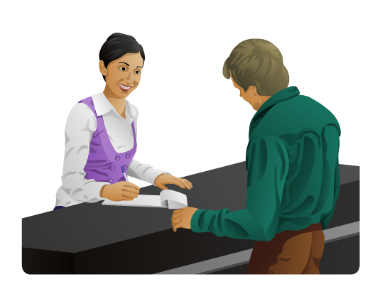
Data Networking Role, Components, and Challenges
Basic characteristics of communication
Rules or agreements are 1st established
Important information may need to be repeated
Various modes of communication may impact the effectiveness of getting the message across.

Slide 11
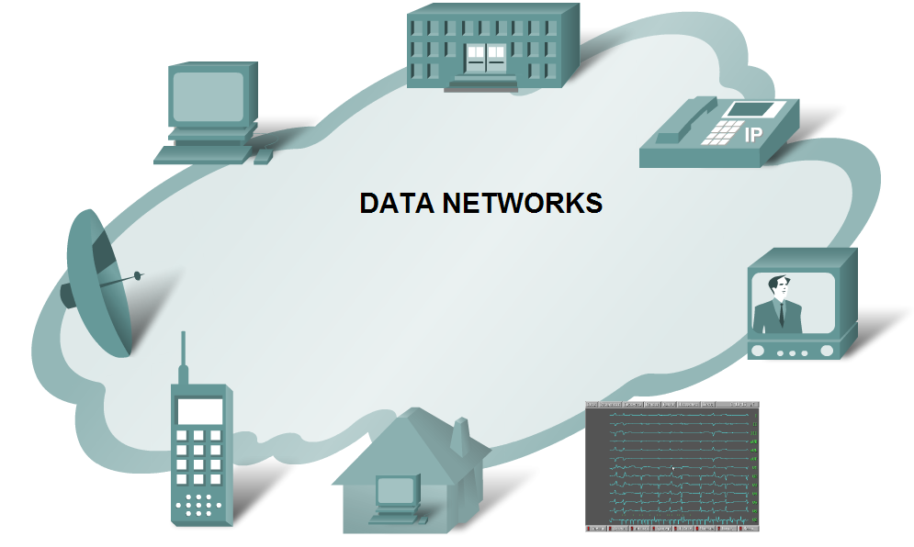
Data Networking Role, Components, and Challenges
Describe the role of data networking in communications

Slide 12
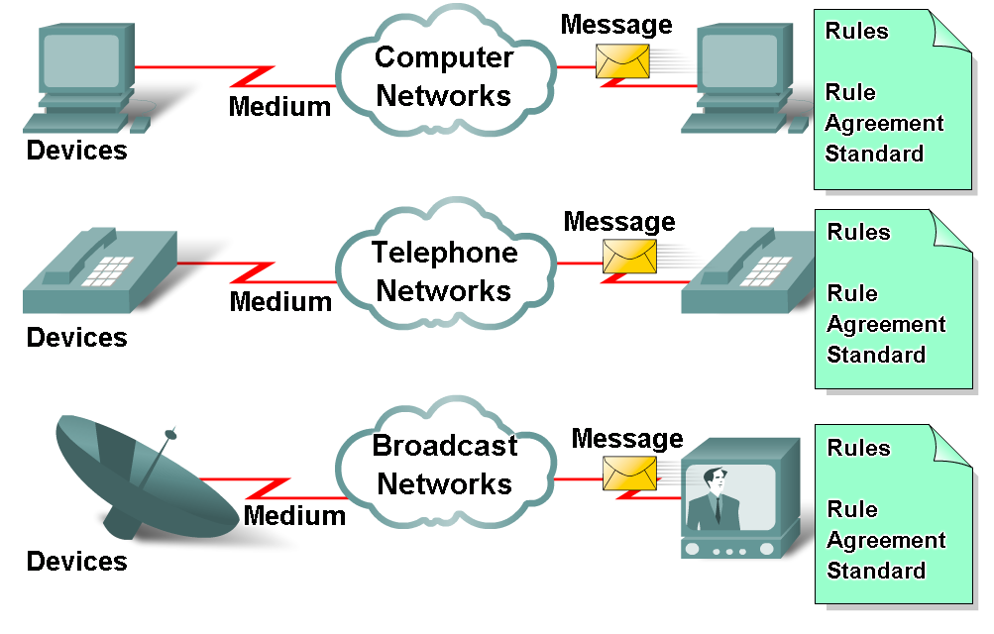
Data Networking Role, Components, and Challenges
Describe the various elements that make up a network
Devices
These are used to communicate with one another
Medium
This is how the devices are connected together
Messages
Information that travels over the medium
Rules
Governs how messages flow across network

Slide 13
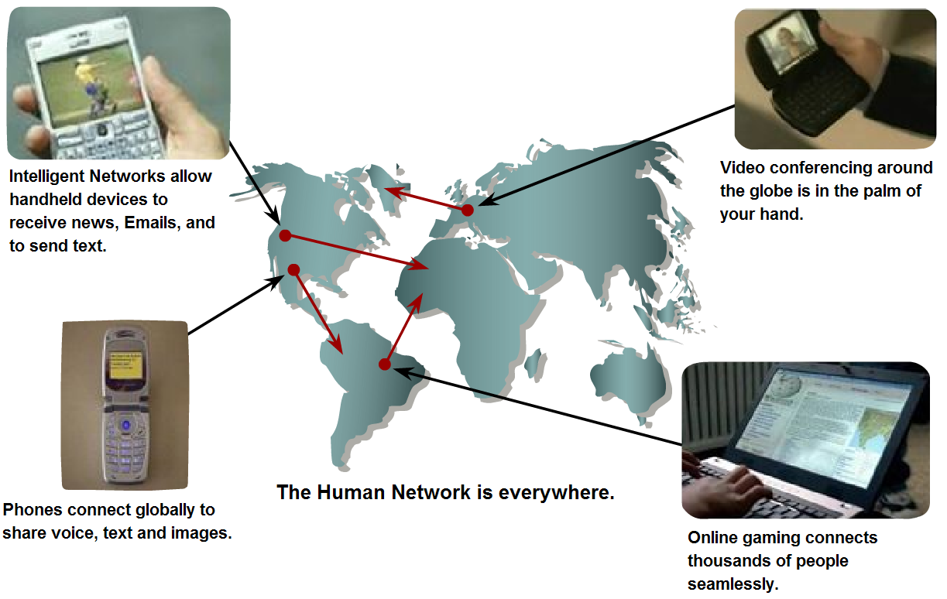
Data Networking Role, Components, and Challenges
Describe the role of converged networks in communications
Converged network
A type of network that can carry voice, video & data over the same network

Slide 14
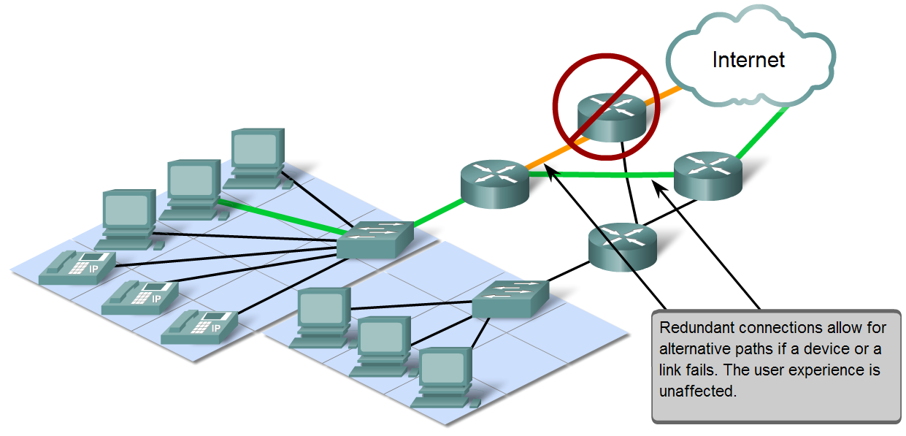
Network Architecture Characteristics
Explain four characteristics that are addressed by network architecture design
Fault tolerance
Scalability
Quality of service
Security

Slide 15
Fault tolerance
Fault tolerance, simply stated, means that the Internet will continue to function normally even when some of the components of the network fail. Redundancy, or the duplication of equipment and media, is a key factor in fault tolerance. If a server fails, a redundant server performing the same functions should be able to pick up the work until repairs are made. If a data link fails on a fault-tolerant network, messages will be routed to the destination on a duplicate route. Figure 1-4 depicts a fault-tolerant network with a failed network router.

Slide 16
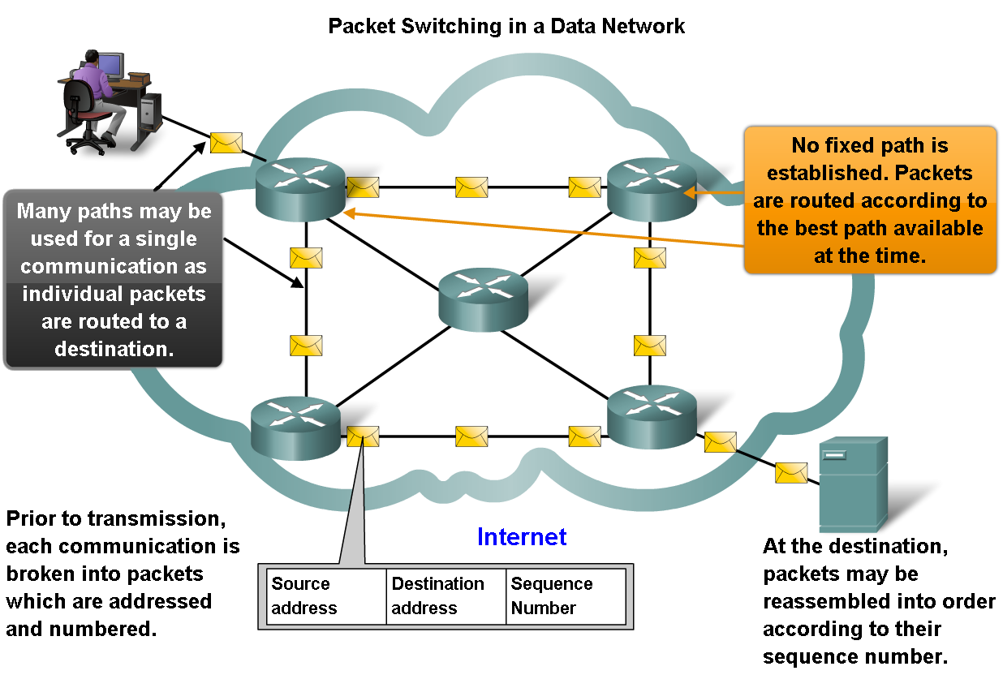
Network Architecture Characteristics
Describe how packet switching helps improve the resiliency and fault tolerance of the Internet architecture

Slide 17
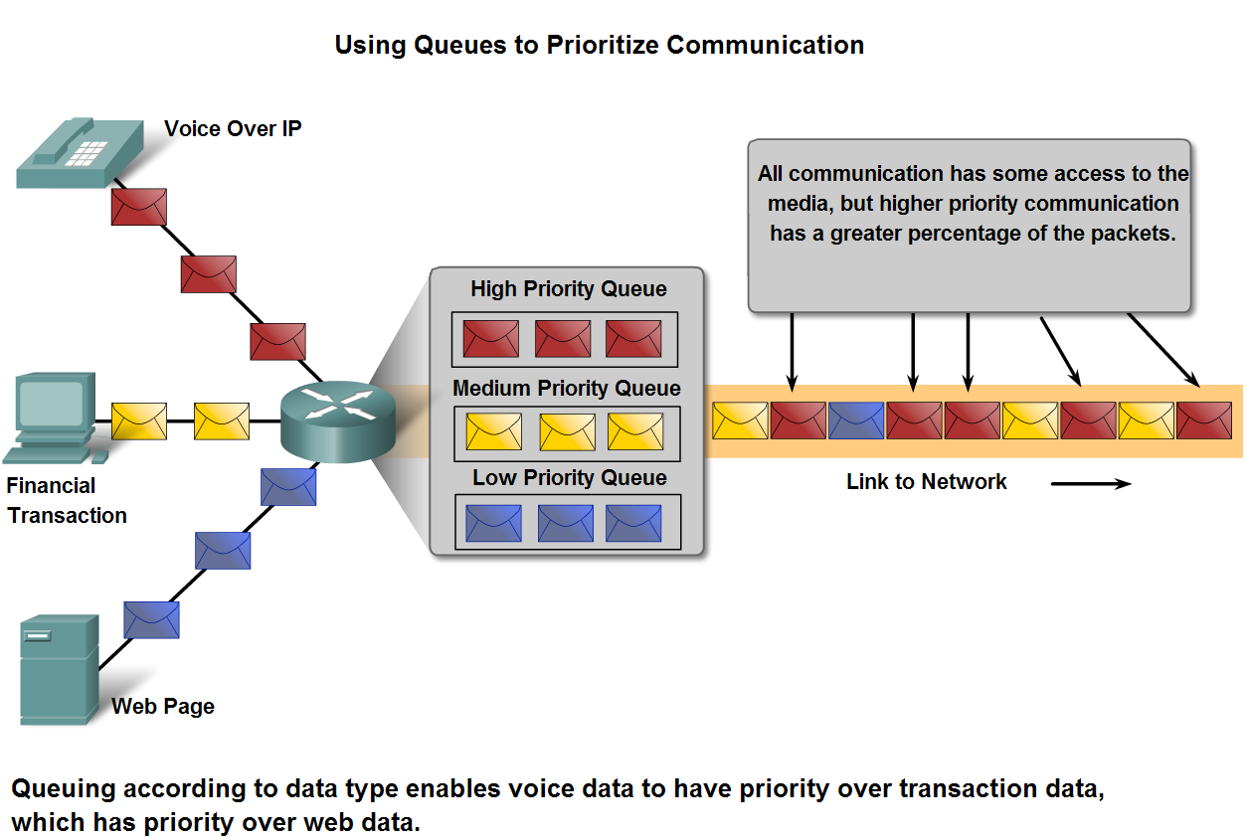
Network Architecture Characteristics
Explain the factors that necessitate Quality of Service and the mechanisms necessary to ensure it

Slide 18
Scalability
Scalability describes the network’s ability to grow and react to future changes. A scalable network can accept new users and equipment without having to start over on the design.

Slide 19
Quality of Service
QoS indicates the performance level of services offered through the network. Services such as live video or voice can require more resources than services such as e-mail. Because
many technologies are converged onto one platform, the separation of types of services on that platform can allow higher priority for one service over another. For example, a network administrator can determine that the data from attendees of a web meeting has priority over e-mail service. Configuring devices to prioritize types of data is an example of QoS.

Slide 20
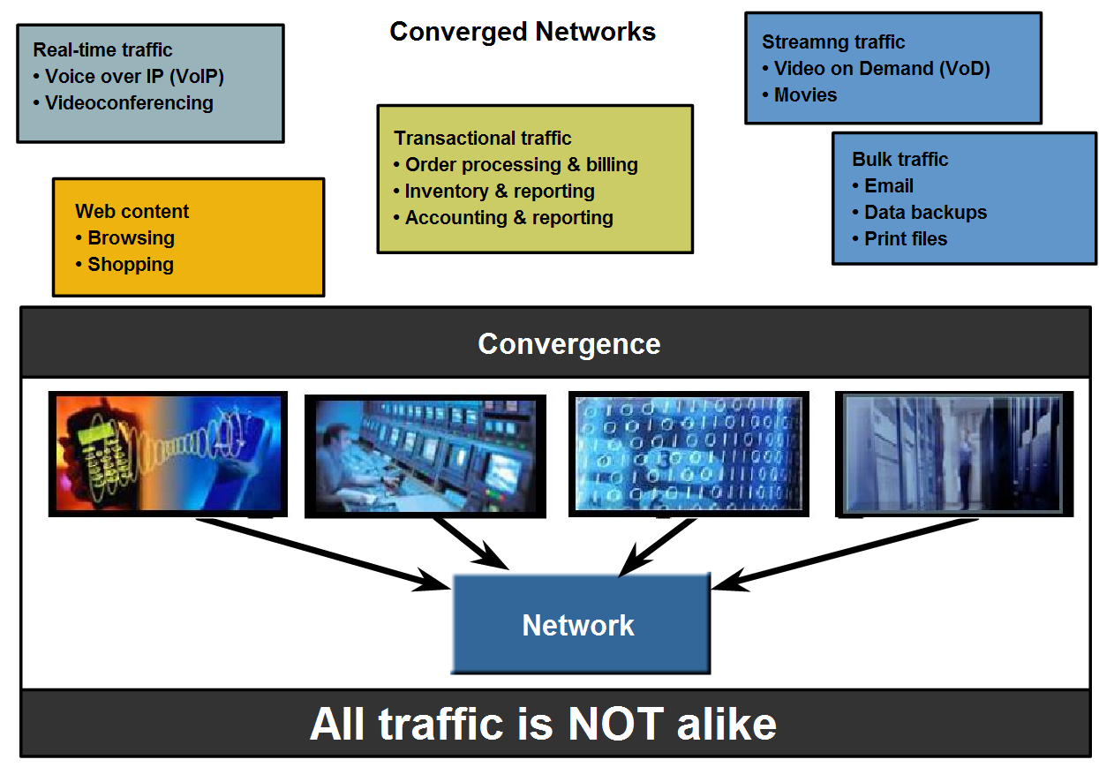
Network Architecture Characteristics
Describe how QoS mechanisms work to ensure quality of service for applications that require it.

Slide 21
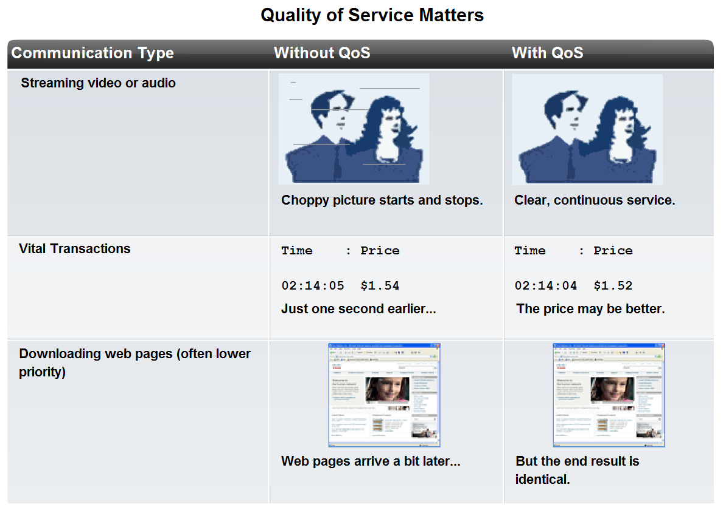
Network Architecture Characteristics
Describe how to select the appropriate QoS strategy for a given type of traffic

Slide 22

Security
Confidentiality
Prevent the disclosure of sensitive information from unauthorized people, resources, and processes
Integrity
The protection of system information or processes from intentional or accidental modification
Availability
The assurance that systems and data are accessible by authorized users when needed

Slide 23
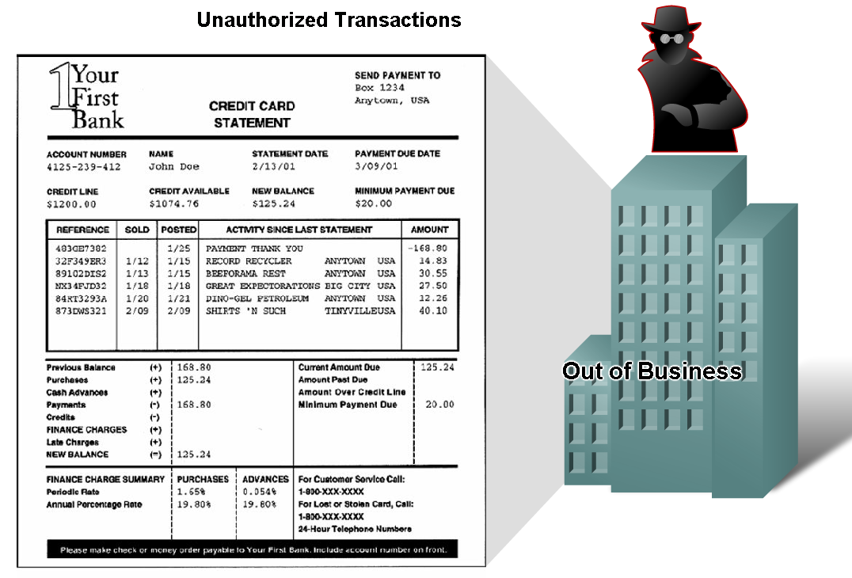
Network Architecture Characteristics
Describe why networks must be secure

Slide 24
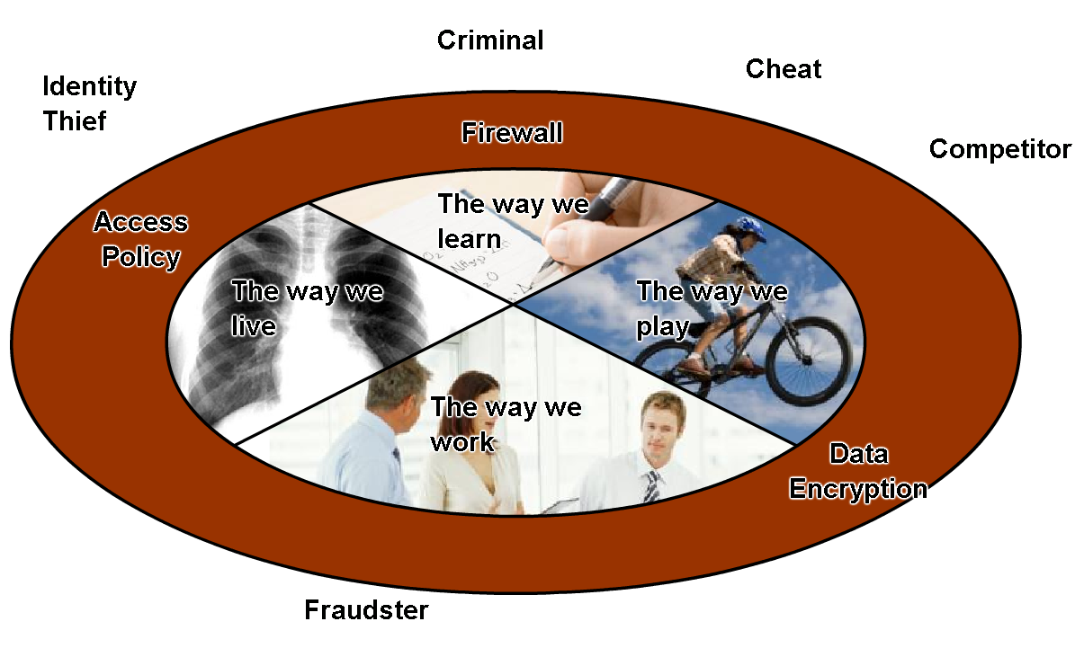
Network Architecture Characteristics
Describe basic measures to secure data networks
Ensure confidentiality through use of
User authentication
Data encryption
Maintain communication integrity through use of
Digital signatures
Ensure availability through use of
Firewalls
Redundant network
architecture
Hardware without a single
point of failure

Slide 25
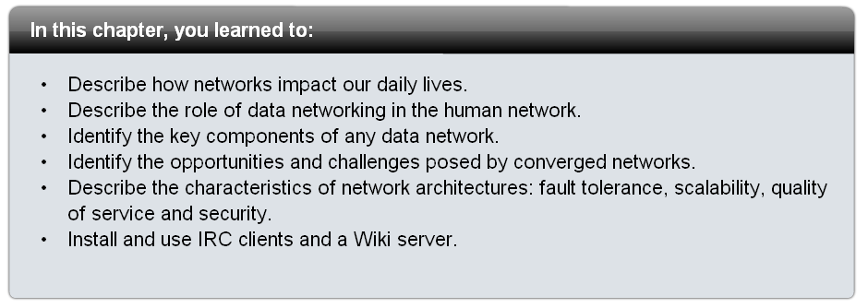
Summary

